Slide 1

CSS Hates You

Slide 2
Yes ! You!

Slide 3
Asshole

Slide 4

Browsers

Slide 5
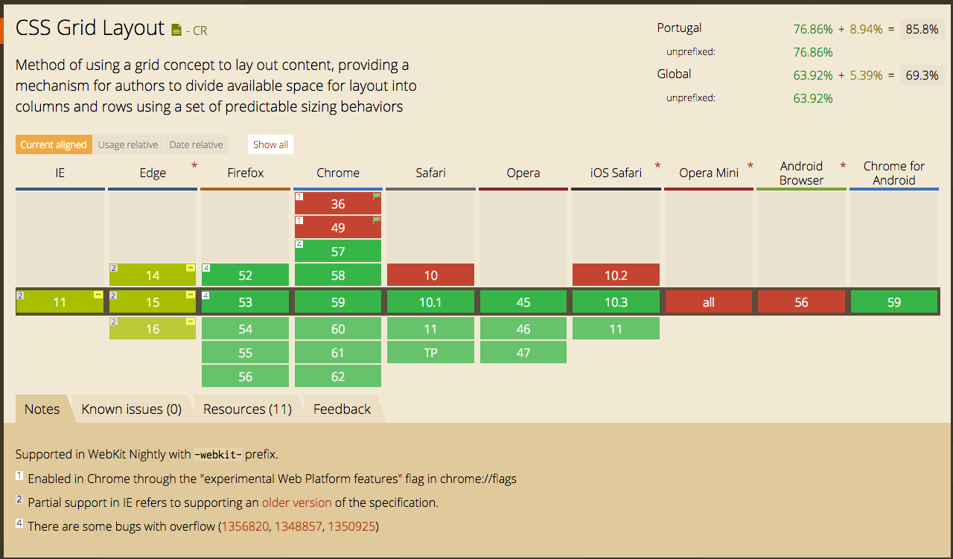
Browsers

Slide 6


Slide 7

Opera Mini

Slide 8
Opera Mini is the Death
Of a developer

Slide 9
Opera Mini is the Death
Of a developer

Slide 10
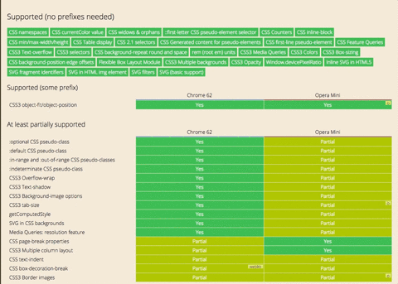

Slide 11
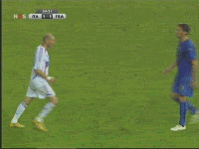

Slide 12

Randomness

Slide 13
Z-Index

Slide 14
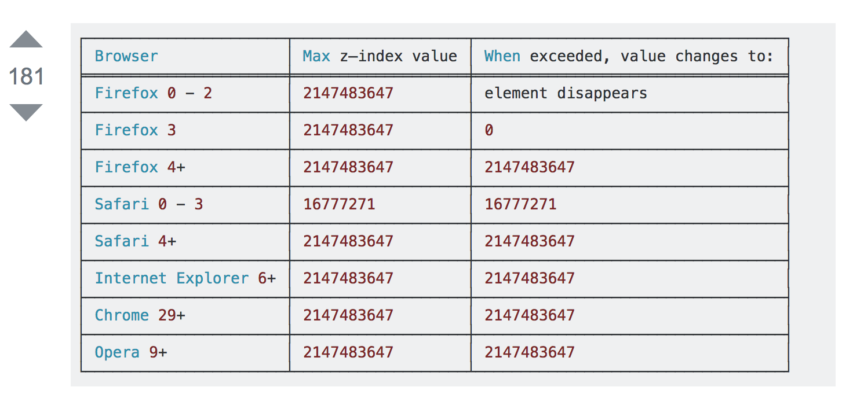
Z-Index

Slide 15


Slide 16
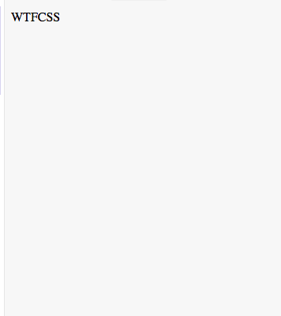
<div class=”wrapper”>
<div class=”one”>WTF</div>
<div class=”two”>CSS</div>
</div>
<style>
.wrapper {
background: red;
}
.wrapper .one,
.wrapper .two {
Float: left;
}
</style>

Slide 17
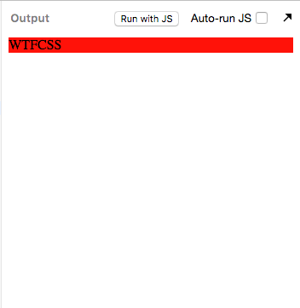
<div class=”wrapper”>
<div class=”one”>WTF</div>
<div class=”two”>CSS</div>
</div>
<style>
.wrapper {
background: red;
overflow: auto;
}
.wrapper .one,
.wrapper .two {
Float: left;
}
</style>

Slide 18


Slide 19

Specificity

Slide 20
Specificity
<div class=”wrapper”
style=”background:red !important”>
<div class=”one”>WTF</div>
<div class=”two”>CSS</div>
</div>

Slide 21


Slide 22
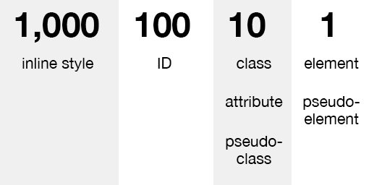
Specificity

Slide 23
Let’s talk about preprocessors

Slide 24


Let’s talk about preprocessors

Slide 25
You have variables now

Slide 26

You have variables now

Slide 27
And Nesting
Before:
section {
display: block;
}
section ul {
display: flex;
}
section ul li {
list-style: none
}

Slide 28
And Nesting
After:
section {
display: block;
ul {
display: flex;
li {
list-style: none;
}
}
}

Slide 29
Better ah ?

Slide 30
We as humAns tend to fuck
everything up

Slide 31
section {
display: block;
ul {
display: flex;
li {
list-style: none;
&:first-child {
background: red;
a {
color: blue;
span {
Text-decoration: strike;
}
}
}
}
}
}

Slide 32
People didn’t like this

Slide 33
Also preprocessors didn’t solve
Specificity issues

Slide 34
This goes specifically at you LESS

Slide 35
Less has a calc function

Slide 36
Wait ! CSS has a calc function !
Wait ! It gets worse

Slide 37
Less
CSS
section {
width: calc(100px - 20px) // works
Height: calc(100% - 20px) // wtf is this?
}
section {
width: calc(100px - 20px) // works
Height: calc(100% - 20px) // works
}

Slide 38
Less
CSS
section {
width: calc(100px - 20px) // works
height: ~"calc(100% - 20px)" // works
}
section {
width: calc(100px - 20px) // works
height: calc(100% - 20px) // works
}

Slide 39
Why ?

Slide 40
There is an option to turn this off
This options break legacy code

Slide 41


Slide 42

BEM

Slide 43
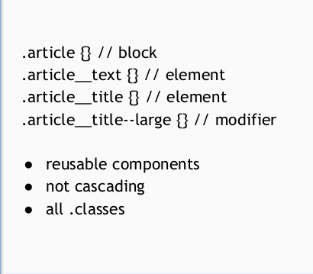
BEM

Slide 44
Again,

Slide 45
We as humAns tend to fuck
everything up

Slide 46
.shoping__btn--disabled--primary--large--has-icon--i-ran-out-of-classes:before {
Content: ‘Wat ?’
}

Slide 47


Slide 48
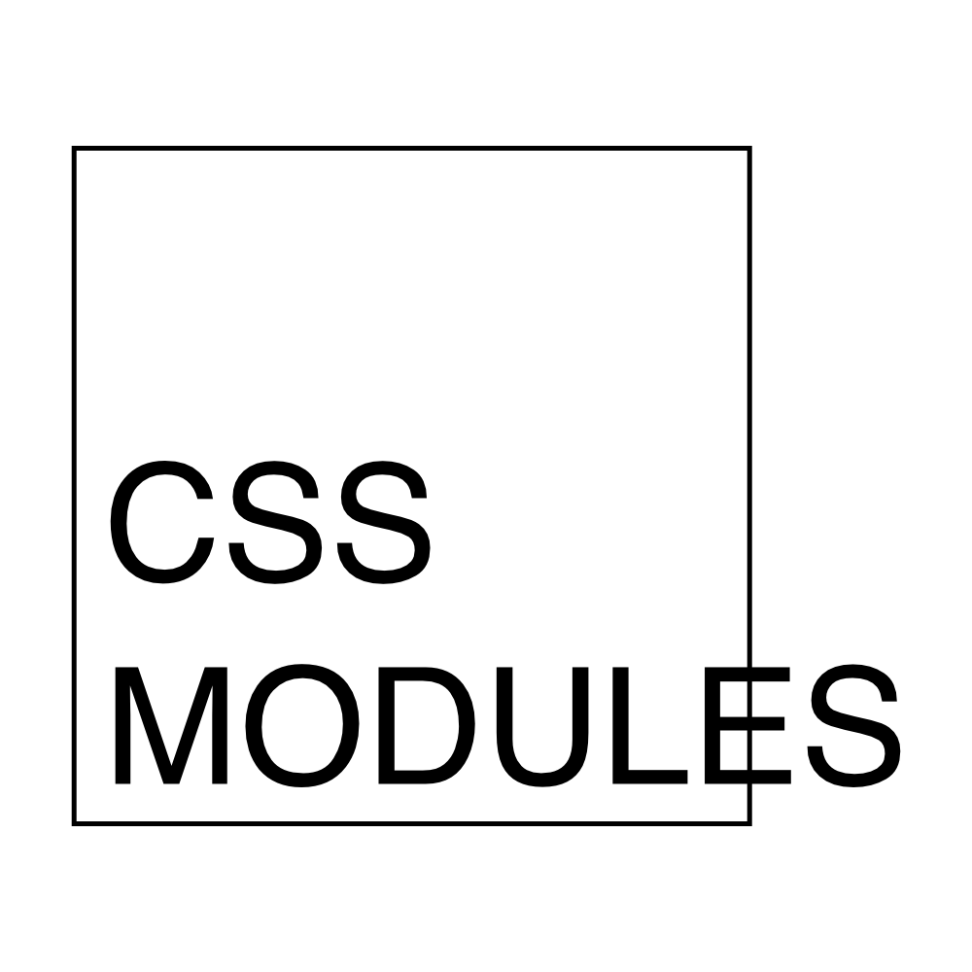
CSS Modules

Slide 49
CSS Modules
import React from 'react';
import style from './style.css';
const Title = ({ children }) =>
<h3
className={style.sectionTitle}>
{children}
</h3>;
export default Title;

Slide 50
CSS Modules
.sectionTitle,
.section-title {
font-family: 'Roboto';
font-size: 16px;
font-weight: bold;
padding-bottom: 2px;
border-bottom: 1px solid gray;
margin-bottom: 16px;
text-transform: uppercase;
margin-top: calc(8px * 2);
display: flex;
align-items: center;
color: var(--color-text-title);
}

Slide 51
Awesome ah ?

Slide 52
CSS Modules
import React from 'react';
Import classnames from ‘classnames’;
import style from './style.css';
const Title = ({ children, active }) =>
<h3
className={classnames({
[style.sectionTitle]: true
[style.active]: active
})>
{children}
</h3>;
export default Title;

Slide 53
CSS Modules
.sectionTitle,
.section-title {
font-family: 'Roboto';
font-size: 16px;
font-weight: bold;
padding-bottom: 2px;
border-bottom: 1px solid gray;
margin-bottom: 16px;
text-transform: uppercase;
margin-top: calc(8px * 2);
display: flex;
align-items: center;
color: red;
&.active {
color: gray
}
}

Slide 54
We as humans are never happy

Slide 55
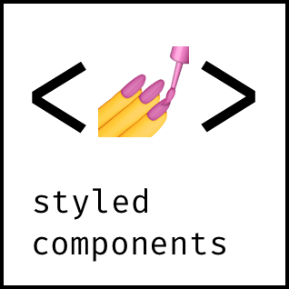
Styled
Components

Slide 56
Styled
Components
import React from 'react';
import styled from 'styled-components';
import {SectionTitle} from './style.js;
const Title = (props) =>
<SectionTitle>
{props.children}
</SectionTitle>;
export default Title;

Slide 57
Styled
Components
const SectionTitle = styled.h3`
font-family: 'Roboto';
font-size: 16px;
font-weight: bold;
padding-bottom: 2px;
border-bottom: 1px solid gray;
margin-bottom: 16px;
text-transform: uppercase;
margin-top: calc(8px * 2);
display: flex;
align-items: center;
color: red;
${props => props.active && css`
color: gray;
`}
`

Slide 58


